Slide 1
Predicting high potential employees and employees at risk
Team members
G . Vyshnavi
B . Kusala Kumari
D . Sai Santoshi Bhavani
K . Jahnavi
Nabeeha

Slide 2
Objective
This project is aimed at predicting the employees who are high potential and who are at risk in earlier stage (jobs) to promote the growth of their business, which is of importance to either an organization or a company.

Slide 3
Technical description
We developed the code from different models using python in Jupyter Notebook by taking the dataset an predicted the scoring of the employees.
Python syntax allows programmers to express concepts in fewer lines of code.

Slide 4
introduction
If a company does not have satisfied employees ,it will not have satisfied customers and there could be possibility of not having satisfied shareholders as well. Great talent is scarce and in high demand in this competitive era and it is very hard to keep the great talent within the same organization . Apparently, it becomes utmost important to understand the drivers of employee dissatisfaction.
Employee scoring is done so high potential employees can be predicted and given high salary whereas company can reduce the salary or fire employees to increase the growth of their business

Slide 5
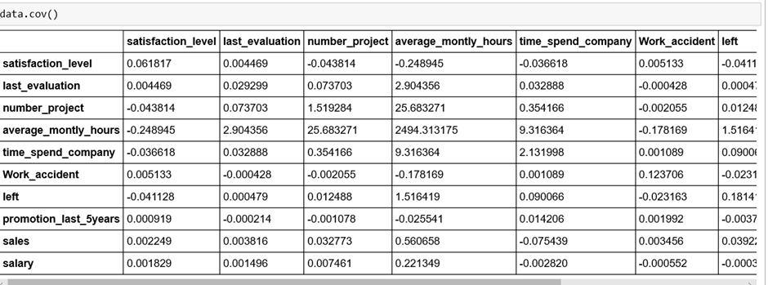
Important code snippet

Slide 6
OLS Regression Results
Dep. Variable: | satisfaction_level | R-squared: | 0.864
Model: | OLS | Adj. R-squared: | 0.864
Method: | Least Squares | F-statistic: | 1.059e+04
Date: | Fri, 21 Jun 2019 | Prob (F-statistic): | 0.00
Time: | 12:32:30 | Log-Likelihood: | -114.81
No. Observations: | 14999 | AIC: | 247.6
Df Residuals: | 14990 | BIC: | 316.2
Df Model: | 9
Covariance Type: | nonrobust

Slide 7
 | coef | std err | t | P>|t| | [95.0% Conf. Int.]
last_evaluation | 0.5131 | 0.012 | 44.190 | 0.000 | 0.490 0.536
number_project | -0.0320 | 0.002 | -17.339 | 0.000 | -0.036 -0.028
average_montly_hours | 0.0010 | 4.21e-05 | 24.151 | 0.000 | 0.001 0.001
time_spend_company | 0.0119 | 0.001 | 8.662 | 0.000 | 0.009 0.015
Work_accident | 0.0216 | 0.006 | 3.777 | 0.000 | 0.010 0.033
left | -0.2185 | 0.005 | -45.438 | 0.000 | -0.228 -0.209
promotion_last_5years | 0.0228 | 0.014 | 1.639 | 0.101 | -0.004 0.050
sales | 0.0128 | 0.001 | 19.472 | 0.000 | 0.011 0.014
salary | 0.0582 | 0.003 | 19.442 | 0.000 | 0.052 0.064
Omnibus: | 645.357 | Durbin-Watson: | 1.952
Prob(Omnibus): | 0.000 | Jarque-Bera (JB): | 718.112
Skew: | -0.527 | Prob(JB): | 1.16e-156
Kurtosis: | 2.800 | Cond. No. | 1.45e+03

Slide 8
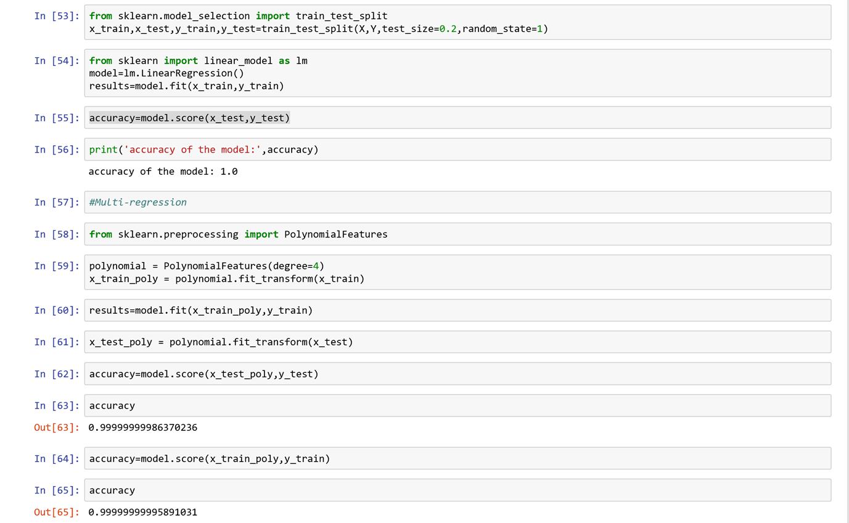
ACCURACY

Slide 9
Modules
Importing the data into python
Data cleaning
Data splitting
Training data
Model evaluate
Testing data
Prediction of data

Slide 10
Problem statement
Employees with high potential should be predicted/preferred initially so that companies can recruit them at earlier stages without any risk and they can be given higher salaries rather than giving to the employees who are not working
It is important to solve the problem because company’s growth revolves around the work/projects done by the employees.
So if we predict an employee with high potential in the earlier stage itself, we can solve the problem of job termination.

Slide 11
INPUTS AND OUTPUT Variables:
INPUT:
Last evaluation
Average monthly hours
Number projects
Time spent
Work accident
Left
Promotion
Salary
Sales
OUTPUT
Satisfaction level

Slide 12
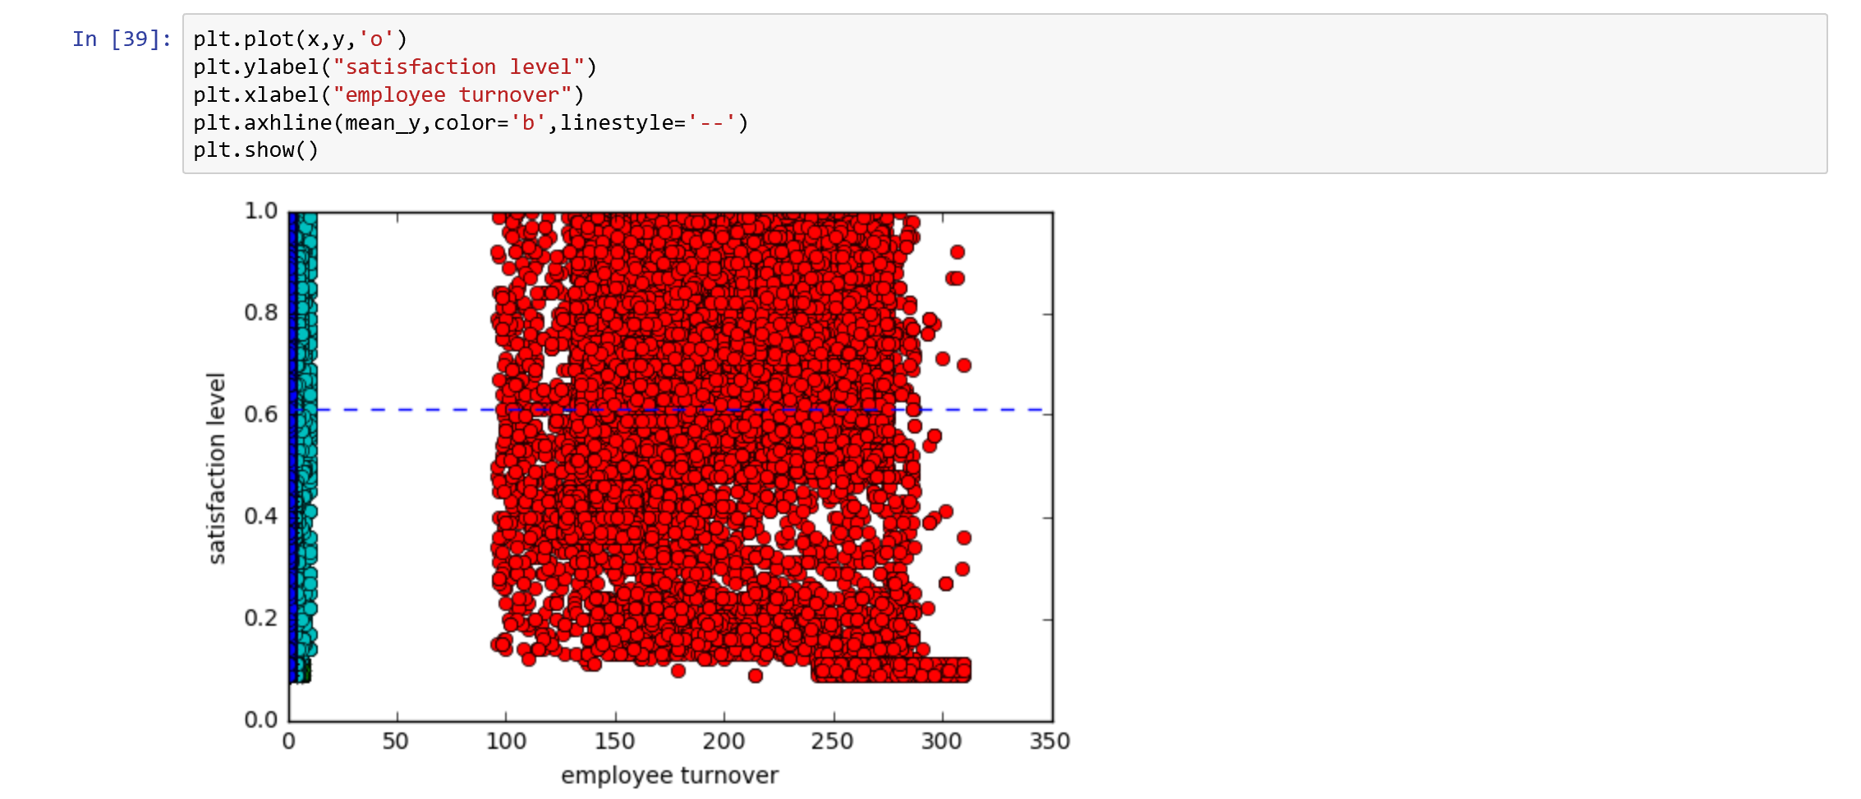
visualisation

Slide 13
conclusion
We developed this project using python3.
By taking the dataset we evaluated with different models and checked the accuracy for which model we can get maximum percentage so that particular model can be sustained and taken as good model.

Slide 14

Thank you

